Slide 1
Managing Asynchronous APIs
Ian Cooper (@ICooper)

Slide 2
Who are you?
Software Developer for more than 25 years
Stuff I care about: Messaging, EDA, Microservices, TDD, XP, OO, RDD & DDD, Code that Fits in My Head, C#
Places I have worked: DTI, Reuters, Sungard, Beazley, Huddle, Just Eat Takeaway
No smart folks
Just the folks in this room

Slide 3
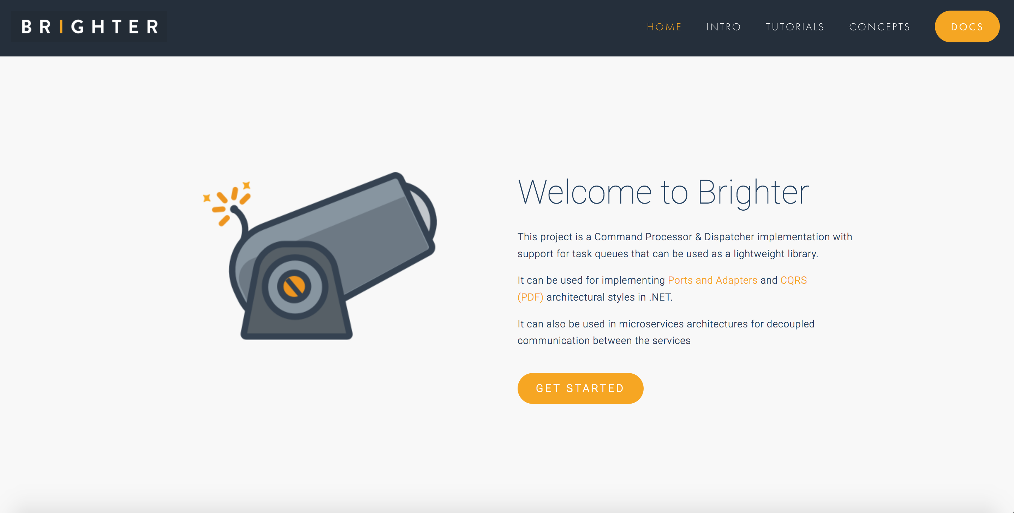

Slide 4
Agenda
Endpoints
Endpoint Discovery
AsyncAPI
Describing Endpoints
Tools
vNext

Slide 5
Synchronous Conversation
In a synchronous conversation, both parties must be present for communication to succeed.
Example: a phone call
Request
Reply
Many options for how describe these: OpenAPI, GraphQL, gRPC, Thrift, SOAP etc

Slide 6

Asynchronous Conversation
In an asynchronous conversation, the receiver does not need to be present at the time the sender communicates with them, using store and forward to pick up the message later.
Example: snail mail
Request
Response
How do we describe these?

Slide 7
Endpoints
5

Slide 8
Endpoints are places where messages are sent or received (or both), and they define all the information required for the message exchange.
An endpoint describes in a standard-based way where messages should be sent, how they should be sent, and what the messages should look like.
https://docs.microsoft.com/en-us/dotnet/framework/wcf/fundamental-concepts

Slide 9
Bounded Context
A bounded context is a model of our domain - there can be many models of the same domain (local viewpoints) - or of the subdomains of the domain - and thus there can be many bounded contexts
A bounded context finds expression as code, schemas, etc. used by a team (or teams). A microservice is implicitly a bounded context
Restaurant
Restaurant
Restaurant Availability
Restaurant Management
We name a bounded context.
Within a bounded context we may have differing representations of a domain concept - for example a restaurant - because we do not need the same information to perform our function, or due to history.

Slide 10
Customer Supplier
Because of the dependency we often use the phrase: supplier for the upstream team and customer for the downstream team. The supplier needs to meet the needs of the customer.
A downstream team depends upon an upstream team. If the upstream team makes changes to its model the downstream team must react.
Customer
Supplier
Upstream
Restaurant
Restaurant
Restaurant Availability
Downstream
Restaurant Management

Slide 11
Model Integration Approach - Conformance
In conformance, the customer uses the internal model of the upstream - this creates coupling between the two which removes independent deployability. It is antithetical to microservices.
Upstream
Restaurant
Restaurant
Restaurant Availability
Downstream
Restaurant Management

Slide 12
Model Integration Approach - Anti-Corruption Layer
An anti-corruption layer provides an ad-hoc translation service per customer that translates the format used by the supplier to that understood by the customer.
Upstream
Restaurant
Anti-Corruption Layer
Restaurant
Restaurant Availability
Downstream
Restaurant Management

Slide 13
Model Integration Approach - Open Host Service
An open-host service reduces the duplication of many anti-corruption layers by supporting shared models. The upstream team agrees to support an external model that may differ from their internal one. It implies an open host model that supplier agrees to support and customer agrees to depend upon.
Upstream
Open Host Service
Restaurant
Restaurant
Restaurant Availability
Downstream
Restaurant Management

Slide 14
Open Host Service – Necessary Coupling
An open-host service creates coupling between the supplier and customer. This is necessary coupling because to collaborate with others we must allow others to take a dependency on us.
The contract makes necessary coupling habitable for both supplier and customer.
Dependency
Open Host Service
Restaurant
Restaurant
Restaurant Availability
Restaurant Management
In promise theory the service is an agent that makes a promise about its capabilities.
An open-host service provides a contract – provided we honor that contract, we can change our service implementation details.
We document a contract so all sides know what they can rely on.

Slide 15
Open Host Service - Endpoints
Contract
Binding
Address
(ABC)
Upstream
Endpoint
Restaurant Availability
Downstream
Restaurant Management

Slide 16
Endpoints are places where messages are sent or received (or both), and they define all the information required for the message exchange.
An endpoint describes in a standard-based way where messages should be sent, how they should be sent, and what the messages should look like.
https://docs.microsoft.com/en-us/dotnet/framework/wcf/fundamental-concepts

Slide 17
Endpoint Discovery
15
What are our Requirements?

Slide 18


- Do I want to search all the GitHub Repos in case you documented it?
- Do I want to put a message out on Slack or Teams asking if anyone knows who exposes it?
?
Restaurant Availability
How do I know who exposes the data that I need? How do I find the endpoint that I want to consume from?

Slide 19
- Do I search all the GitHub Repos looking for the name of my message hoping to find it?
- Do I want to put a message out on Slack or Teams asking if anyone consumes it?
?
Endpoint
RestaurantHoursChanged
Restaurant Management
Who consumes the messages I send? Whom do I have a contract with?

Slide 20
What protocol do you use to share this message?
What channel should I listen to for this message?
What metadata is supplied with the message?
RestaurantHoursChanged
Endpoint
Restaurant Management
What is the content type of this message?
What is the schema of this message?
How is this message encoded?

Slide 21
Endpoint – Documenting the Contract
An endpoint is where messages should be sent, how they should be sent, and what the messages should look like. What promises do we make.
Endpoint
We will need to agree what the metadata – the headers are – and we will need to agree the encoding and schema of the body.
An message is data that we send or receive
Message
Upstream
Metadata (Headers)
RestaurantHoursChanged
Endpoint
Data (Payload)
Downstream
Restaurant Management
Channel
A channel is the logical pipe over which messages flow
Binding
A binding is the details of how we implement the channel: what transport and encoding does the service support that allows messages to flow for example AMQP and Plain/Text.
In principle you can have multiple bindings for a channel.

Slide 22
Describing Endpoints
20
AsyncAPI

Slide 23
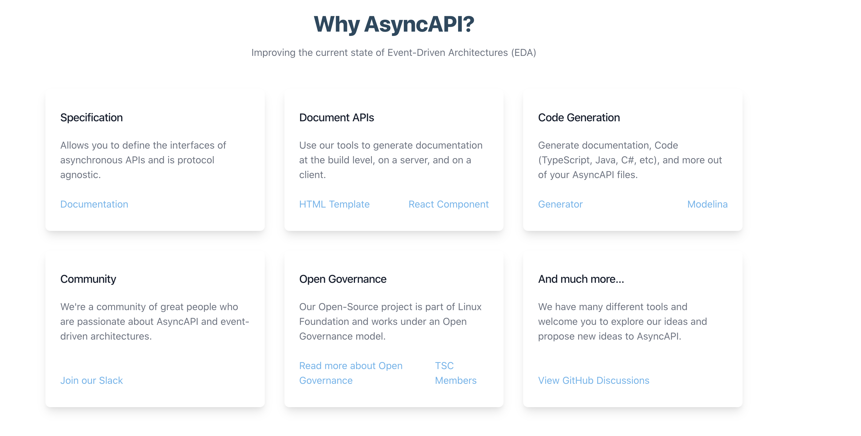

Slide 24
AsyncAPI Elements
An application is running code that acts as a producer (sends messages) or a consumer (receives messages)
A message must have a payload and can have headers. Headers may protocol or application specific.
Producer
Consumer
Message
P
H
Binding
With pub-sub the server is neither producer or consumer, but a broker, but with point-to-point the apps may be in the role of client or server.
Binding
Server
Bindings are protocol specific information
Messages are sent over channels, which are hosted on a server. There may be more than one channel, so the channel must be addressable
Binding
A channel has a protocol by which messages are exchanged.

Slide 25
Document Structure
The root object. Identifies the application being documented
AsyncAPI Object
Metadata for this specification
Info Object
Connection details for the server
Servers Object
The channels being used by the application
Channels Object
The collection of operations on this channel
Channel item Object
Defines an operation – publish or subscribe – made available by the application on this channel
Operation Object
Components Object
Re-usable components
Tags Object
User defined tags for this specification

Slide 26
AsyncAPI Object
id: https://github.com/brightercommand/greetings/
We use a specification file for an app, which is a producer or consumer, and identify them by id

Slide 27
Info Object
info:
contact:
name: Paramore Brighter
url: https://goparamore.io/support
email: support@goparamore.io
license:
name: Apache 2.0
url: https://www.apache.org/licenses/LICENSE-2.0.html
description: Demonstrates sending a greeting over a messaging transport.
title: Brighter Sample App
version: 1.0.0
tags:
- name: brighter examples

Slide 28
Servers Object
local:
url: localhost:9092
protocol: kafka

Slide 29
Channels
greeting:
subscribe:
operationid: sendGreeting
summary: sends a greeting
description: This service lets you send the ‘Hello World’ greeting to another service.
message:
$ref: "#/components/messages/greeting”

Slide 30
Ref
Allows us to re-use an element by using a reference to a definition in the components section
$ref: "#/components/messages/ greeting"
We can use a file reference too – this can be helpful when we want to define the producer and a consumer in separate specifications and share the message schema between them
$ref: ”greetings.yaml#/components/messages/ greeting"

Slide 31
Components
components:
messages:
greeting:
name: greeting
title: A salutation
summary: This is how we send you a salutation
contentType: application/json
traits:
- $ref: '#/components/messageTraits/commonHeaders'
payload:
$ref: "#/components/schemas/greetingContent"
schemas:
greetingContent:
type: object
properties:
greeting:
type: string
description: The salutation you want to send
…

Slide 32
Document Structure
AsyncAPI Object
Endpoint
Info Object
Message
Servers Object
Metadata (Headers)
Data (Payload)
Channels Object
Channel
Channel item Object
Operation Object
Binding
Components Object
Tags Object

Slide 33
The main issue with AsyncAPI today is that it models point-to-point more clearly than pub-sub.

Slide 34
Tools
35
AsyncAPI

Slide 35
What tools help us document our endpoints?

Slide 36
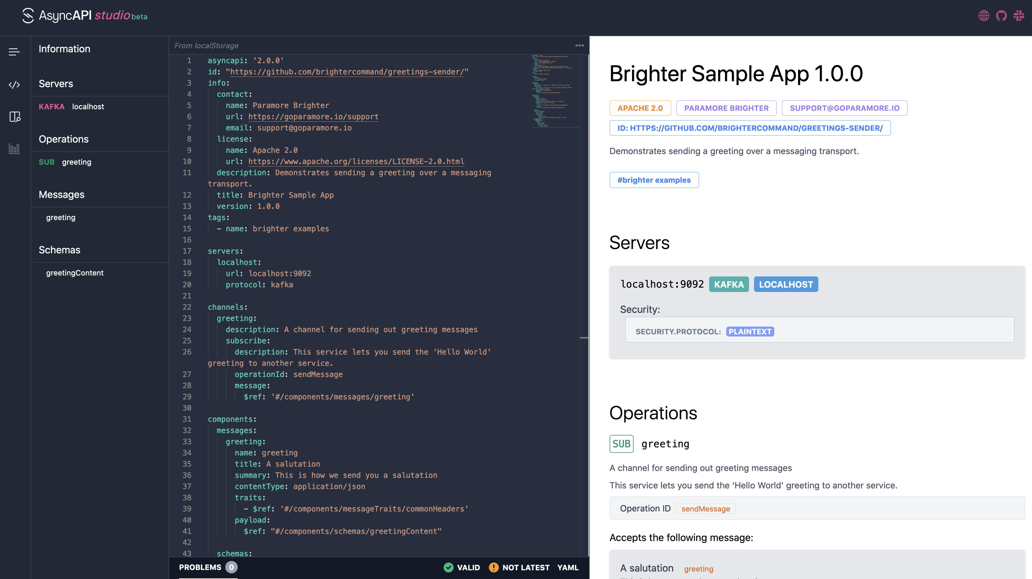

Slide 37
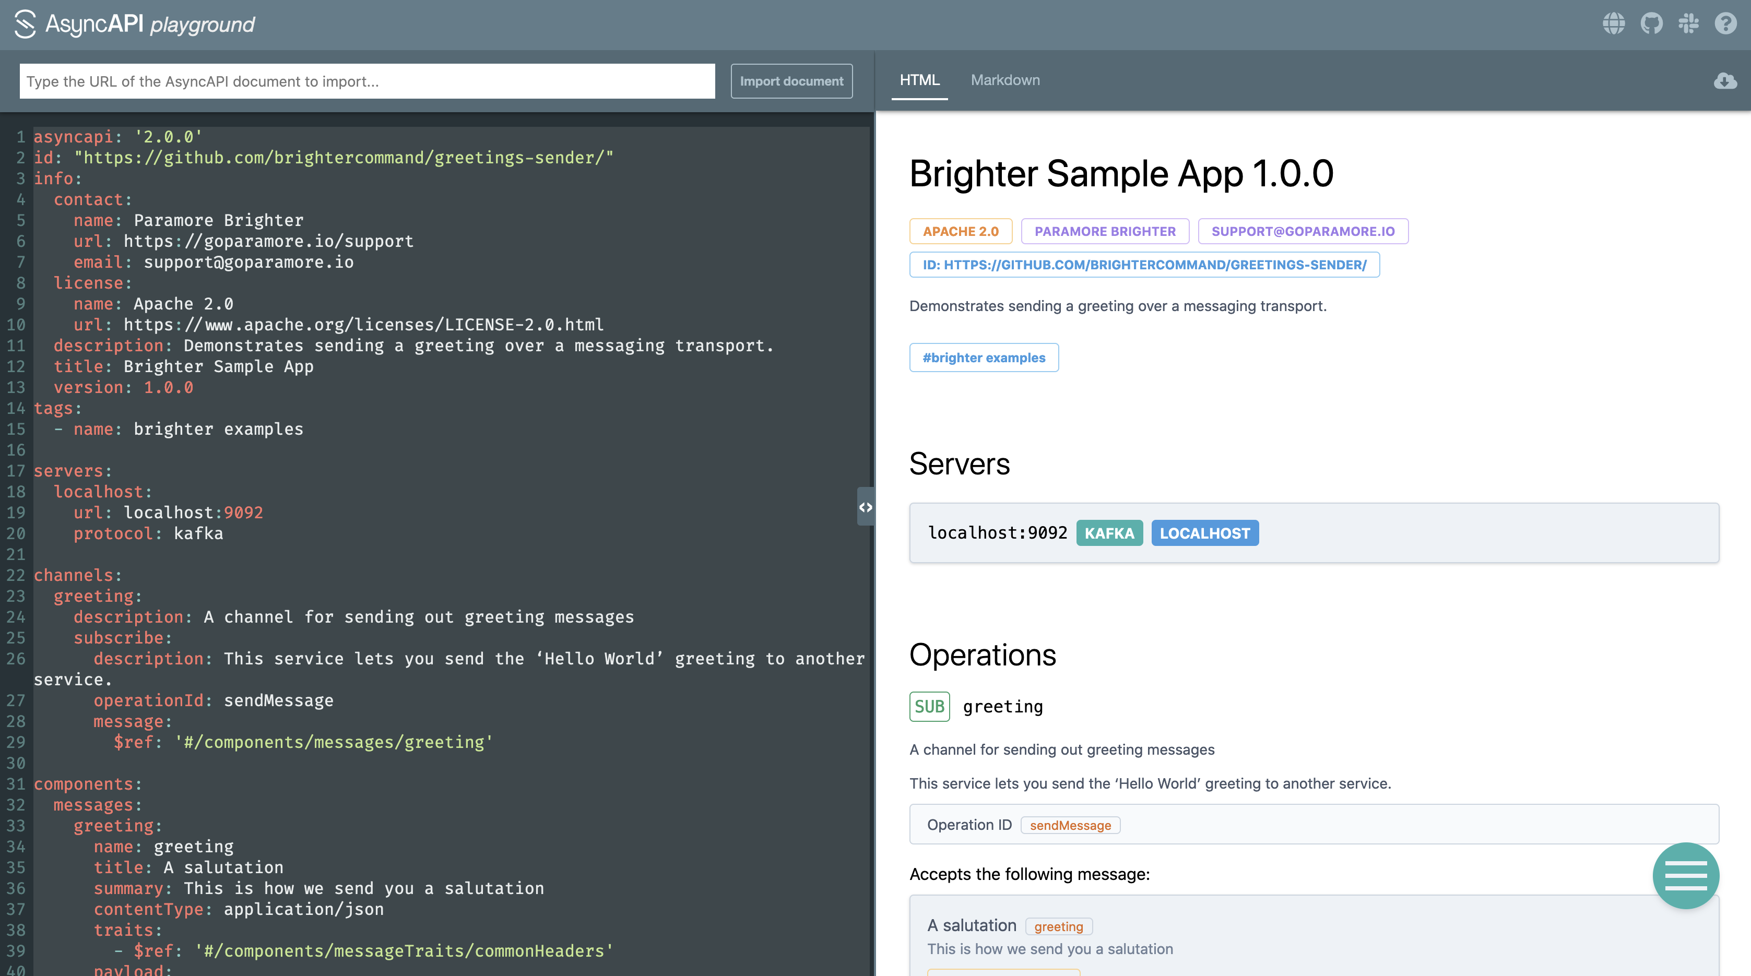

Slide 38
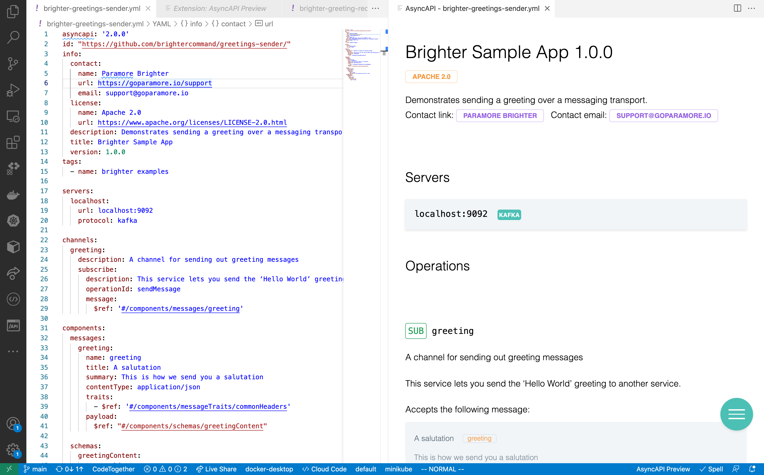

Slide 39
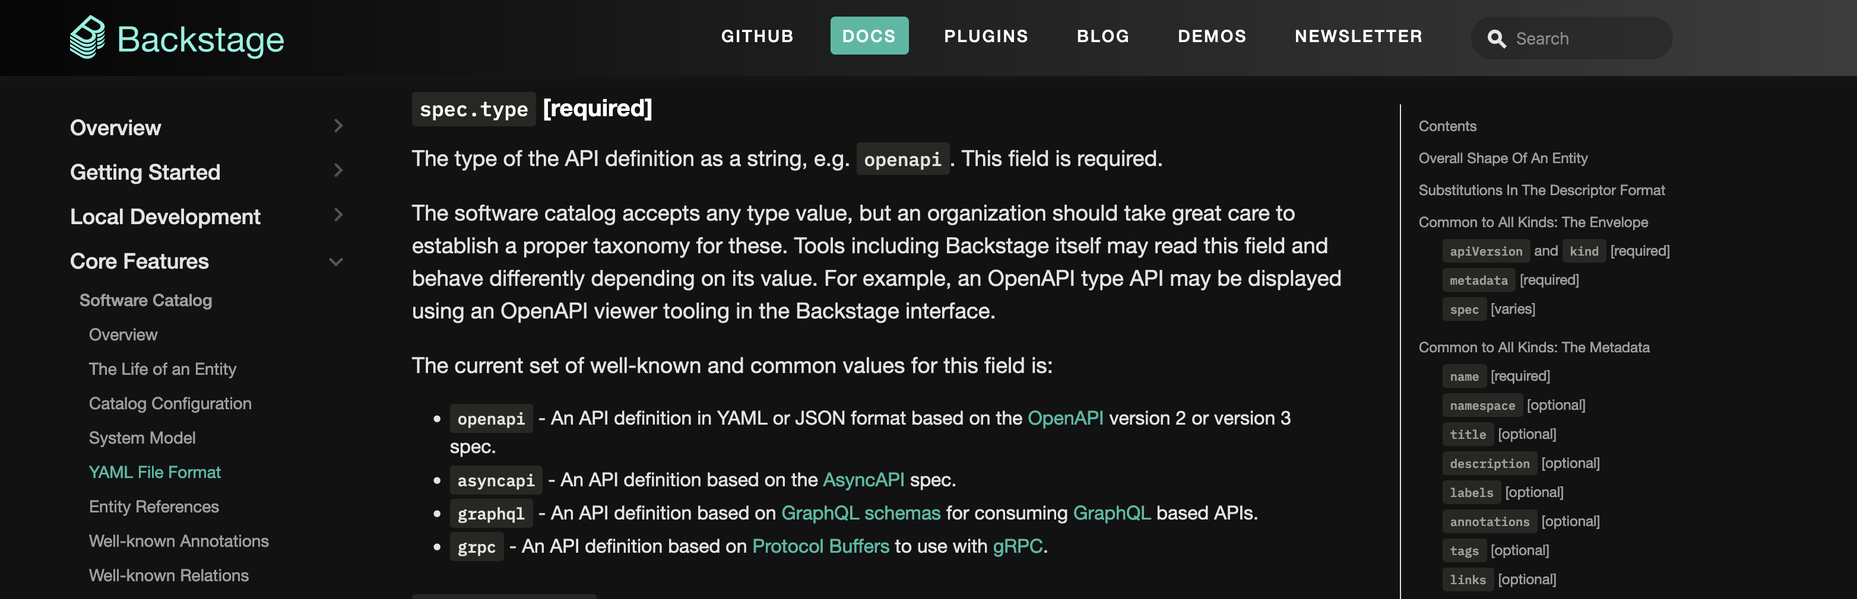

Slide 40
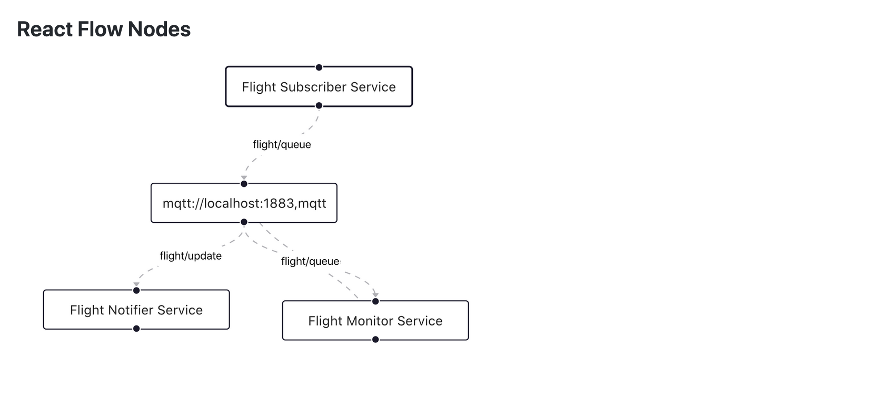
Cupid

Slide 41
What tools help us use our endpoints?

Slide 42





Generators
Take an ascynapi specification.
Parse it.
Use the parsed specification to provide inputs to a template (React or Nunjucks)
Use the template to spit out new files

Slide 43
Using the react template approach, you are parsed an object representing the parsed asyncapi file.
import { File, Text} from '@asyncapi/generator-react-sdk';
import { KafkaConfiguration } from '../components/KafkaConfiguration’;
export default function({ asyncapi, params, originalAsyncAPI }) {
const files = [];
const channels = asyncapi.channels();
if(Object.entries(channels).some(([channelName, channel]) => channel.hasPublish() && channel.publish().hasBinding(”kafka"))){
const filename=”kafka.yaml";
files.push(<File name={filename}><KafkaConfiguration channels={channels}/></File>);
}
return files;
}
You spit out the results as one or more files
You write a custom transform to take that parsed specification and create new output from it.

Slide 44


Documentation
We can generate documentation, such as HTML, to create a catalogue of our services

Slide 45



Infrastructure As Code
The bindings hold information that helps us provision infrastructure. We can extract that, perhaps as JSON
As part of our CI/CD pipeline we can ensure that the infrastructure over which messaging flows exists

Slide 46



Scaffolding

Slide 47
vNext
40
AsyncAPI

Slide 48
The main issue with AsyncAPI today is that it models point-to-point more clearly than pub-sub.

Slide 49
asyncapi: 3.0.0
servers:
local:
url: localhost:9092
description: Confluent local Kafka broker
protocol: kafka
protocolVersion: '1.0.0'
channels:
greeting:
message:
…
operations:
onReceiveGreeting:
action: receive
channel: greeting
description: Receive market updates on a given symbol.
bindings:
kafka:
kind:remote
There is a proposal to remove the publish/subscribe confusion by being using actions instead.
Operations become top-level and separate from channels, to allow re-use of channels
Kind:remote – there is a broker that acts as a intermediary, over direct exposure

Slide 50
End
40

